Slide 1
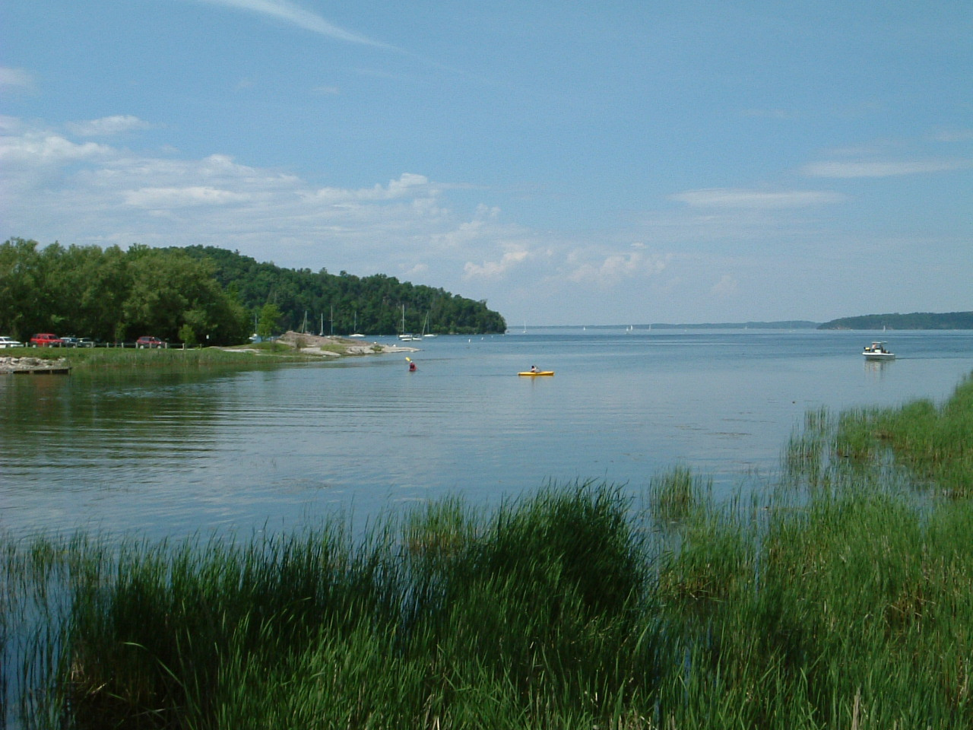
Defining and Targeting High Flows
South Chittenden River Watch
Vermont Monitoring Cooperative Conference
December 2, 2016

Slide 2
SCRW Monitoring Program - Watersheds
River | Drainage Area (sq. mi.) | Impacts on Water Quality
LaPlatte River | 46.36 | Rural, receives treated effluent in Hinesburg
McCabe’s Brook | 4.59
Middle Segment | 1.47 | Agricultural
Downstream Segment | 1.21 | Town of Shelburne storm water
Thorp Brook | 2.93 | Agricultural
Kimball Brook | 1.87 | Agricultural

Slide 3
1. Phosphorus Burdens Associated with Suspended Solids

Slide 4
Comparison of “Critical” Discharge Rates in the
LaPlatte Watershed and Addison County Streams
River | Apparent “Threshold”/ “Critical” Flow (cfs) | % of Mean Daily Discharge Values Less than or Equal to Threshold Flow (cfs) | Period of Record
LaPlatte River | 100 | 87.5 | 1990-2010
Lewis Creek | 450 | 96.7 | 1990-2014
Little Otter Creek | 95 | 83.6 | 1990-2006
Otter Creek | 2,000 | 82.7 | 1990-2006
McCabe’s Brook | 5 | 85 | 2012-2013

Slide 5
2. Particle Size Analysis

Slide 6
3. In-stream Phosphorus Mass Balances

Slide 7
McCabe’s Brook:
A Losing Stream
Many mass failures, gravel deposits, dry beds:
  At low flows water flows through gravel, stream may disappear
At low flows, downstream segment often receives now flow from upstream catchment
Upstream nutrient loadings at times exceed downstream loadings

Slide 8
4. Events Associated with High Flows

Slide 9
5. Loading Rates by Discharge Classes
Median Phosphorus and Solids Loading Rates (Kg/Day) in McCabe’s Brook at Harbor Road (SCRW Data 2011-2014)
Discharge Class Interval | Phosphorus |  |  | Total Suspended Solids
 | Total | Particulate | Dissolved
<1 cfs | 0.10 (5) | 0.07 (4) | 0.05 (4) | 23.98 (5)
1-5 cfs | 0.32 (11) | 0.16 (11) | 0.21 (11) | 75.99 (11)
5-10 cfs | 2.94 (4) | 1.24 (4) | 1.56 (4) | 638.09 (4)
>10 cfs | 7.36 (2) | 5.35 (2) | 2.01 (2) | 3,224.41 (2)

Slide 10
Rough Estimate of % of Total Load Discharged from McCabe's Brook
when Stream Discharge Rates Exceeded 5 cfs
(May 30 to November 11, 2012; May 27 to October 14, 2013)
 | 2012 | 2013
Days of Record | 170 | 137
Phosphorus:
Total | 14 % | 86 %
Particulate | 18 % | 89 %
Dissolved | 7 % | 75 %
Total Suspended Solids | 23 % | 92 %

Slide 11
Conclusions
High flow monitoring requires effort, but has proved feasible
Discharge at the USGS gage on the LaPlatte River has proved a reasonable indicator of discharge in adjacent watersheds
In-stream flow measurement is informative, but not affordable on routine basis
High flow monitoring can pick up events impacting on in-stream water quality and loadings on Lake Champlain
High flow monitoring targets flows representative of entire watersheds providing a better picture of entire watersheds
High flow monitoring tracks the most meaningful data relating to nutrient and sediment loadings on Lake Champlain

Slide 12
Final Questions
Does high flow monitoring present a more
meaningful picture of potential impacts on
receiving water bodies than does random
flow monitoring?
Can high flow monitoring improve our
ability to detect and understand change
over time?

Slide 13
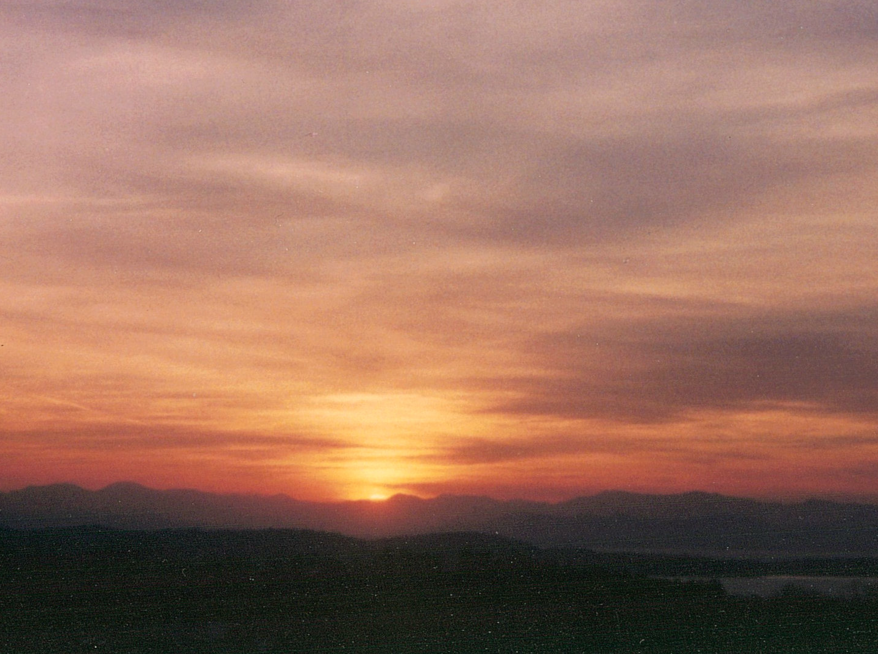
THE END

